Slide 1
Multi-Robot Collaboration for 3D Concrete Printing
IE 574 – Final Project Presentation
Jorge Rojas
Kunal Mamtani
Agathiya Tharun

Slide 2
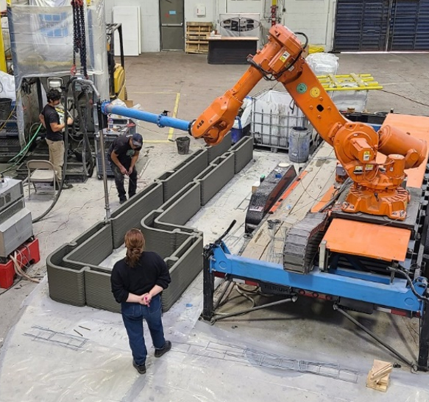
Background
$10 trillion dollar industry
Lack of automation
Construction robots (CoBots) are not an optimal solution
3DCP (3D Concrete Printing)
Innovative and more optimal solution
Growing field with many unresolved challenges

Slide 3
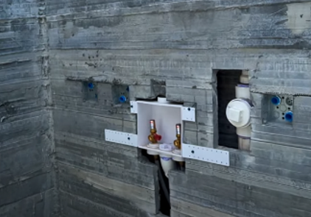
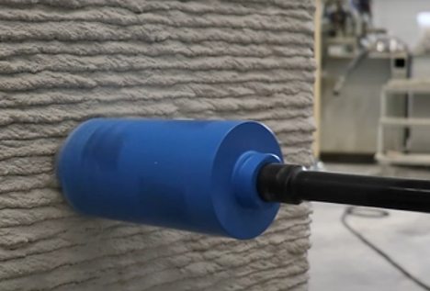
Problem Definition
3DCP poses many challenges; it offers an oversimplified solution in many ways.
Often requires human intervention (sometimes dangerous) to do intricate tasks retrospectively.
Specifically, plumbing, electrical box installation, and laying steel mesh

Slide 4
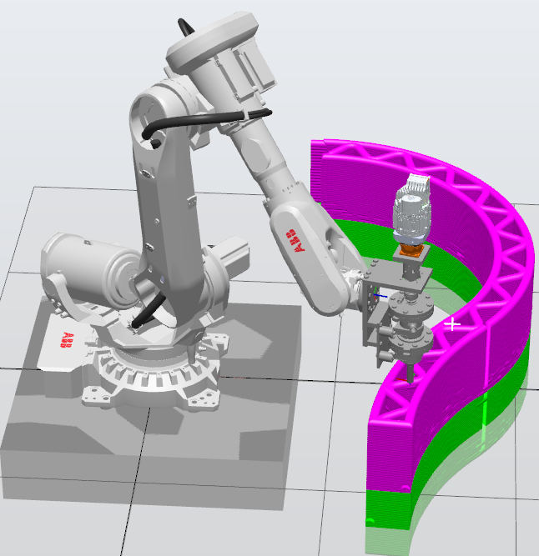
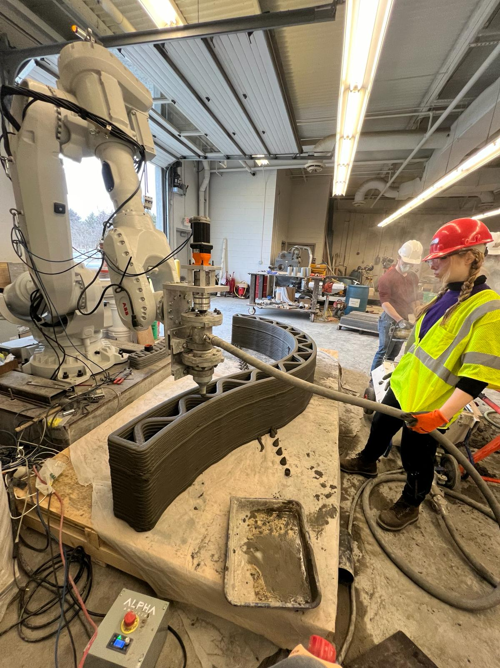
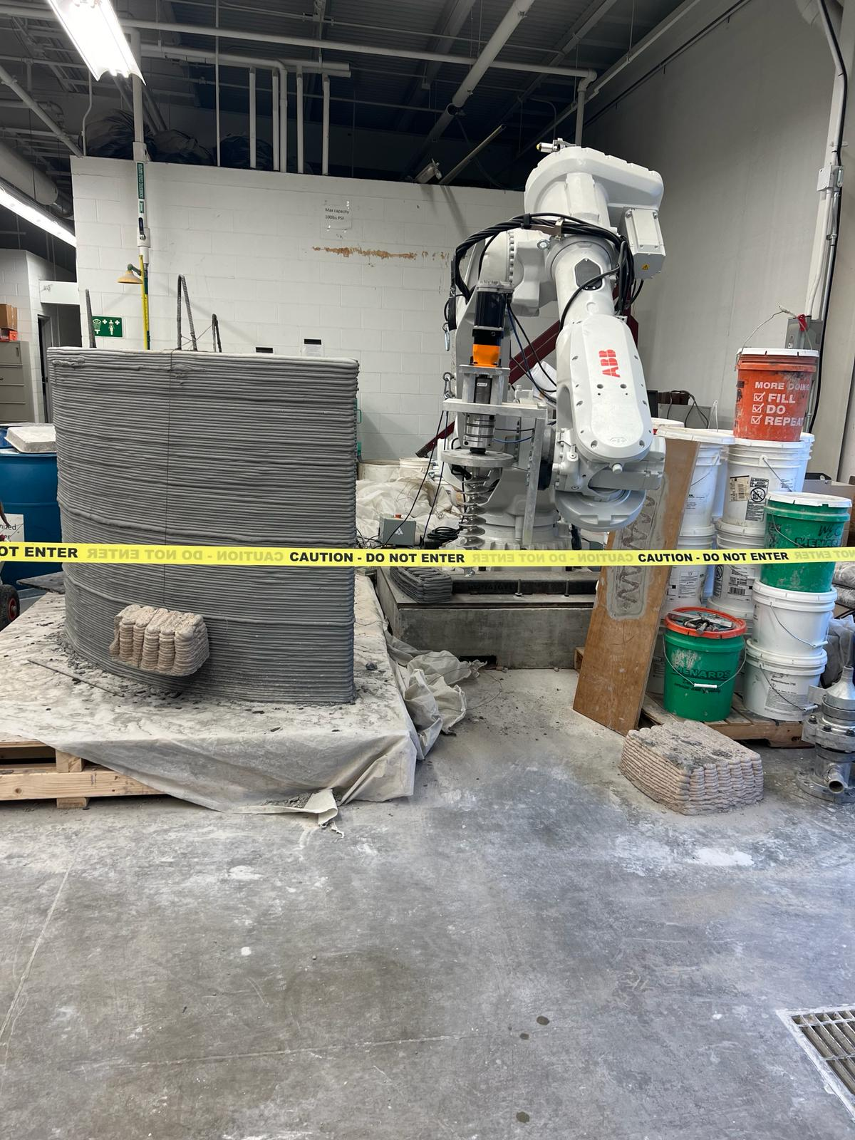
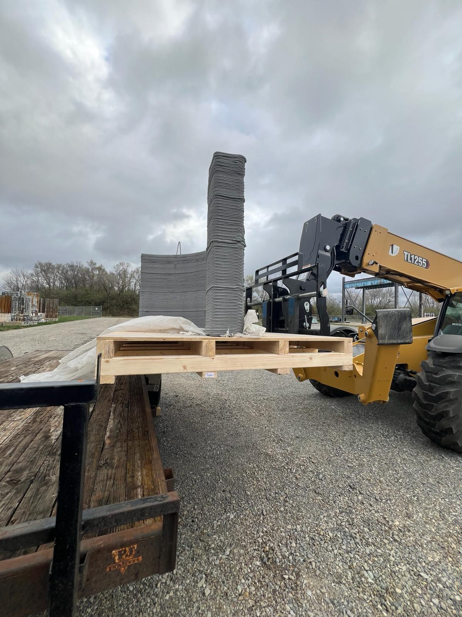
Method
Toolpath planning
and Simulation
3D Printing Process
Rigging anchors
Delivery for assembly

Slide 5
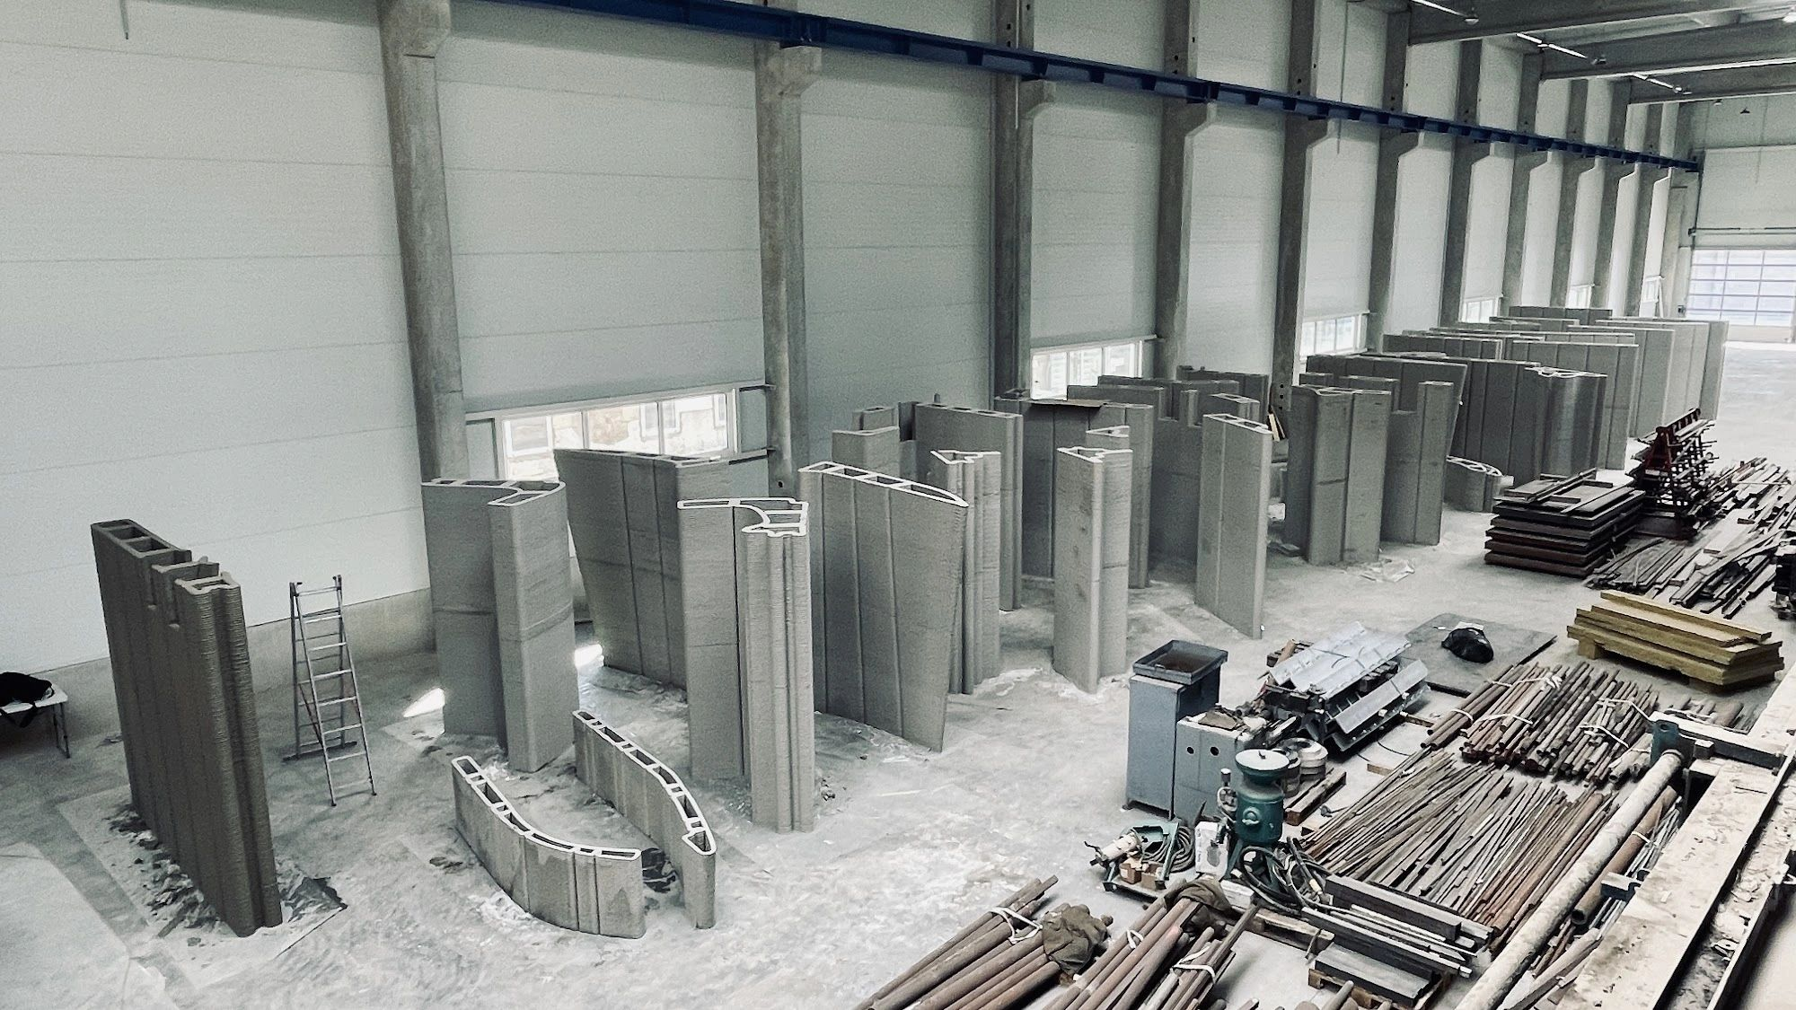
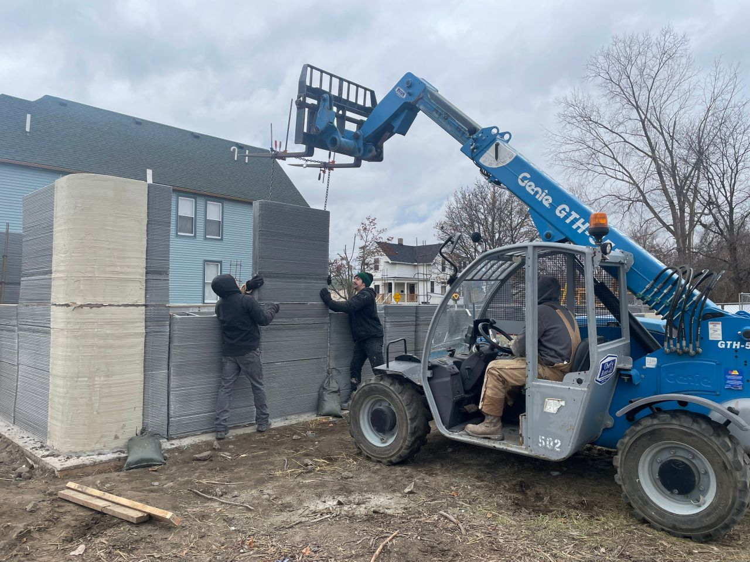
Method
Off-site storage of 3DCP walls
Assembly on-site of 3DCP walls

Slide 6
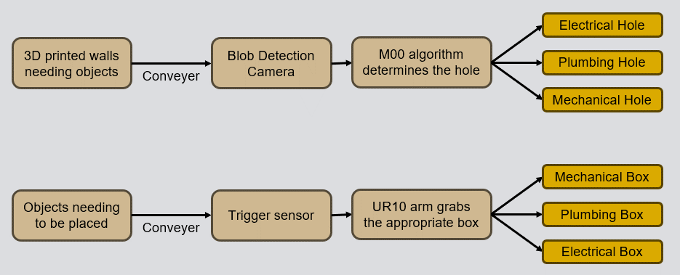
Method
System Diagram

Slide 7
Method
System Diagram
UR10 places the box in its hole

Slide 8
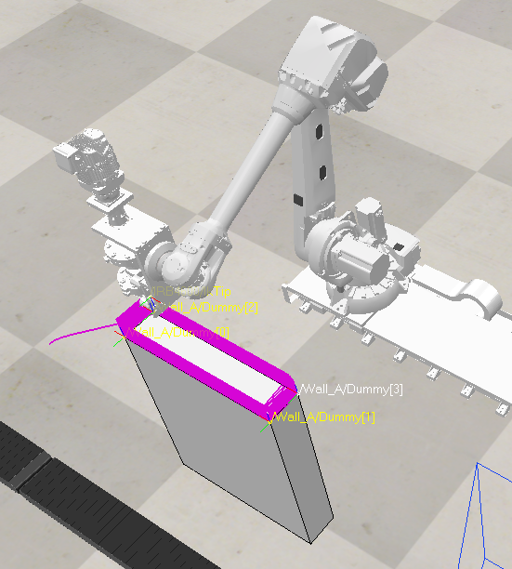
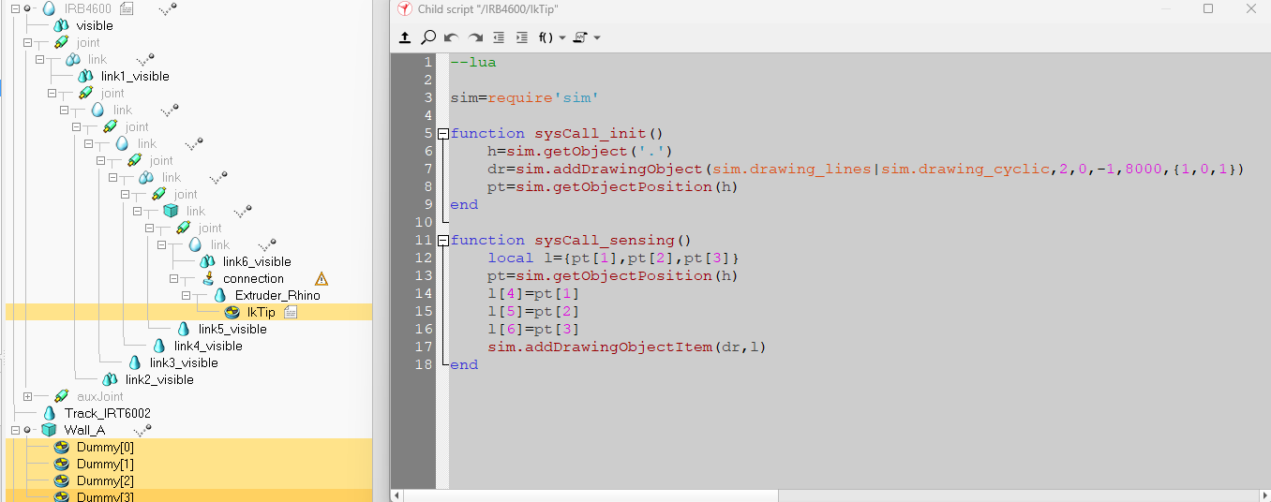
Method
Toolpath planning

Slide 9
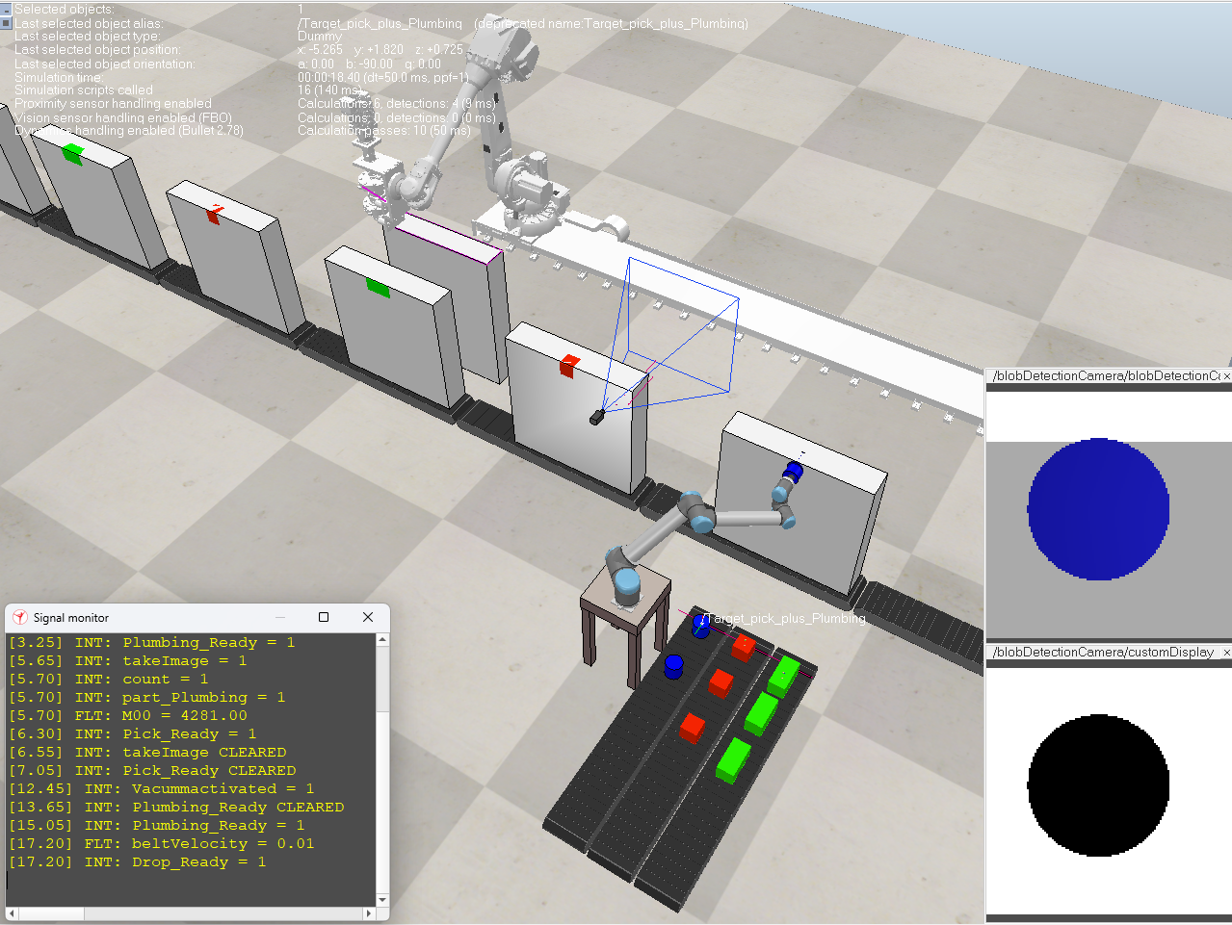
Method
Pick and place of block outs
Calculated 0th order M00 for shape identification
Simple and robust solution ideal for easy geometries
Leveraged blob detection camera to move the Cobot arm
Notes:
Calculated the Zeroth-order moment M00 to determine the shape of the fixture spot.
Very simple and robust solution that works well with simpler geometries.
Utilized the blob detection camera to move the Cobot to place corresponding shape in the fixture hole.

Slide 10
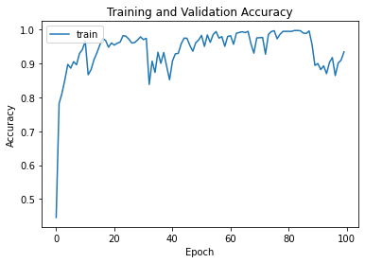
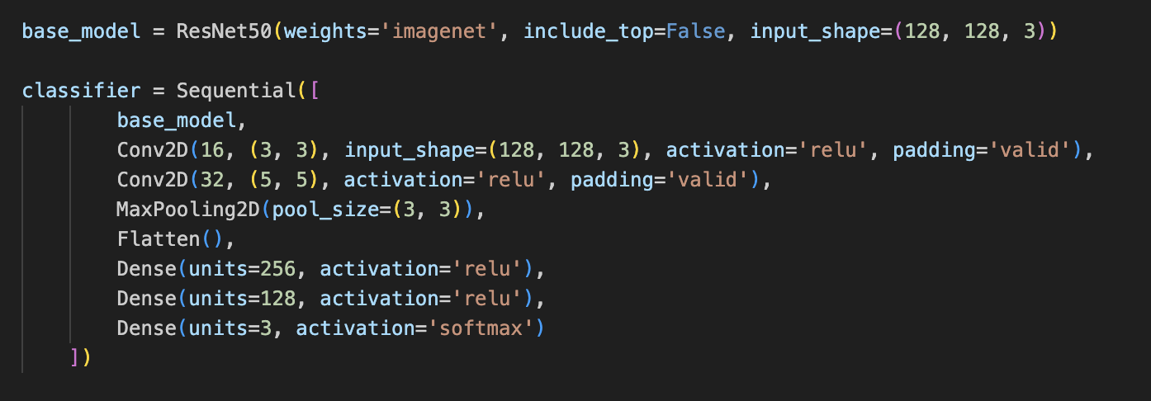
Method
Deep Learning method pick and place of block outs
Use a Deep Learning model to choose the necessary fixture
Trained the model on three classes: Square, Cylinder, and Rectangle
Used a ResNet Model for generalization benefits; with 90% validation accuracy

Slide 11
Main Findings
Two approaches were tested for vision sensing
Zero order moment
Deep learning network
M00 was sufficient for the task implemented but the DL approach needed further integration.
The descriptors approach worked well for the simple classes, but a more robust approach is needed for more complex tasks.

Slide 12
Evaluation
Descriptors are enough for simple geometry classification
Limitations to this approach:
Large variety of hole shapes (geometries, dimensions, and locations).
Variable hole location
Necessity for object detection and localization (not just classification).
Adjustments for inline processing (coordination of time and space for both robots).
A conveyor belt representation isn’t the most realistic
Necessity to install a camera on the robot’s end-effector and not in a fixed position
Necessity of sensing data fusion if complex geometries appear

Slide 13
Conclusion
Traditional construction methods are labor-intensive and time-consuming
3DCP alleviates problems in construction
Lack of labor force
Reduced productivity
There still remain manual tasks that need to be completed alongside the robot printer
Automation of such synergistic activities remains a problem
Installing the block-outs in the wall openings yields potential for automation.

Slide 14
Contributions
Jorge Rojas Kunal Mamtani Agathiya Tharun
Spearheaded environment and simulation development
Drove project direction
Trained deep learning model to be used
Created a classifier file
Evaluated and compiled findings
Attempted deep learning integration

Slide 15
Thank You

